Slide 1
Using ns3 to build datasets for QoS estimation Filip Krasniqi, Jocelyne Elias and Jérémie Leguay
June 11, 2019

Slide 2
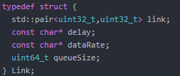
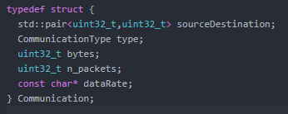
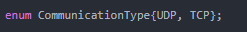
Summary (11/06)
Modeling with Deep Learning
Analyzed datasets from other works
Captured ideas on how modeling evolves when the network changes
Simulation using ns3
Every dataset will be built from a simulation
Different simulations will have in common how the traffic is generated and how the measurement works
A simulation will differ from the other by the topology
Traffic
Poisson process. Given a period P = Ton+Toff, the application will send with a constant rate during Ton, while Toff is exponentially distributed.
Exponential distribution described by µ = mean, β = bound; constant rate is defined by λ.
Measurement
Using trace source. I define a listener for every measure I want to do
Ns3 will just push events that occur at which time. Then, a python code builds the dataset. By doing this, we are able to define the level of granularity of the data
Topology
We have N nodes, L links, F OD flows. Links are all directed links between N nodes.
A link is an instance of the Link structure
An OD flow is an instance of a Communication structure

Slide 3
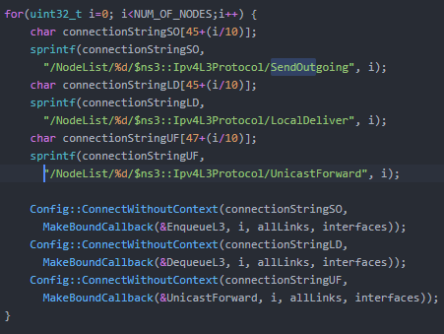
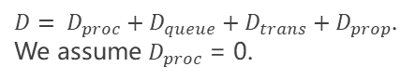
Recognized targets
Per link delay PLD. Matrix NxN.
For each node, we define a trace source on queuing, forwarding and dequeuing. Please refer to SendOutgoing, UnicastForward, LocalDeliver in ns3::Ipv4L3Protocol
Eg: packet p is sent. P1 is packet p on link l1, p2 is p on l2.
0
1
2
Delay on link l1 for p1: t2-t1
Delay on link l2 for p2: t3-t2
l1
l2
$D= D_{proc}+D_{queue}+D_{trans}+D_{prop}$.
We assume $D_{proc}$ = 0.
SendOutgoing: t1
UnicastForward: t2
LocalDeliver: t3
OD flow: (0,2)
End-to-end delay ED. Matrix NxN.
We use same measures as per link delay.
Dataset will be built in a different way, that is, we will not consider the data when origin/destination do not match with current sending / receiving node.
Link loads L. Matrix NxN.
On every link, we define a trace source on the transmission. Please refer to MacTx in ns3::PointToPointNetDevice
Real code to define listeners for per link delay

Slide 4
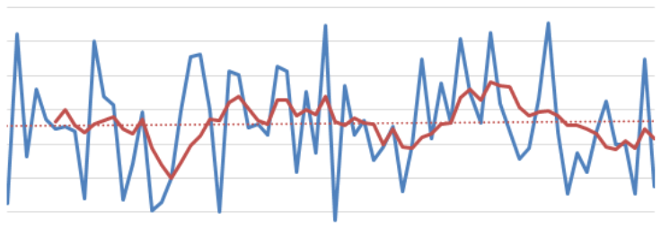
Recognized features
Measurements
Link capacity C. Matrix NxN.
Outgoing queue size Q. Matrix NxN.
Traffic matrix T. Matrix NxN.
To be measured. Value defined for each OD pair.
Routing policy R
Dropped packets D. Matrix NxN.
Per link delay: not really necessary. When a drop occurs the measure is just not considered
End-to-end delay: necessary to distinguish between different delays on given same traffic matrix due to dropped packets
Some considerations
Values depending on time: T, D. Values fixed for a given topology: all the others
For now, we provide the data. During modeling need to understand whether to consider the two types in the same way
GCN: example of using adjacency matrix to initialize weights differently
How to build dataset
We define a period P
For now, P = 60s
For each period, we have an instance of the input features and the associated target
Eg: e2e delay. Goal: learn function f s.t. ED = f(C,Q,T,R,D). Given T obtained averaging the measures over P, D obtained summing all the values during period P, and given C, Q, R we define the target ED by summing all the delays concerning that flow during period P.
-> to have 10 rows, we must run the simulator for an equivalent time of P*10.
By increasing/decreasing the period, we are averaging to smooth the function we want to learn
During modeling, we will try RNN to learn the evolution over time
We will consider which features are actually useful from practicing on the model
Any other idea on useful features that can be added during the measures is welcome.

